Slide 1
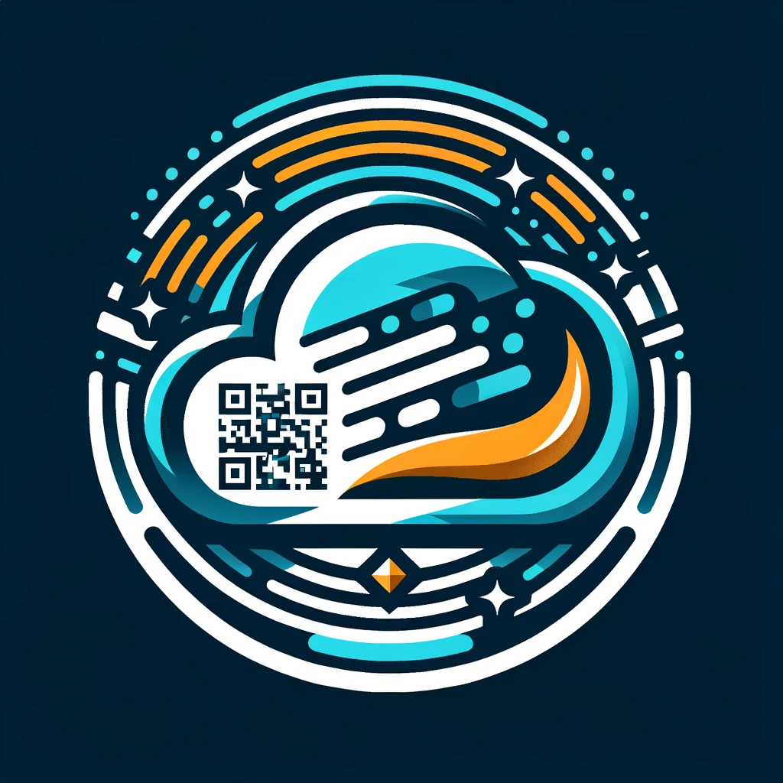
Quickpay QR.
Leveraging cutting-edge AWS cloud technology to propel the swift evolution of Quick Response (QR) transactions.
Hemanth Reddy Mutra

Slide 2

What are QRC’s
Quick Response Codes (QRCs) have emerged as pivotal assets within the financial industry, revolutionizing the landscape of transactions in today's world.
QRC payments are a contactless payment method where customers scan a visual QR Code using their mobile application.
The versatility of QRCs enhances financial inclusivity by accommodating a spectrum of users, from tech-savvy individuals to those with limited access to traditional banking services.
The integration of QRCs with advanced technologies such as cloud computing, artificial intelligence, and mobile applications further amplifies their impact.

Slide 3
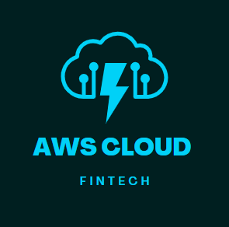
Seamless Integration of AWS Cloud with QRC’s
Here are some reasons why AWS services can be beneficial for building a QR payment system:
1) Scalability
2) Reliability
3) Security
4) Managed Services
5) Flexibility
6) Global Reach
7) Cost Efficiency
8) Developer Tools

Slide 4
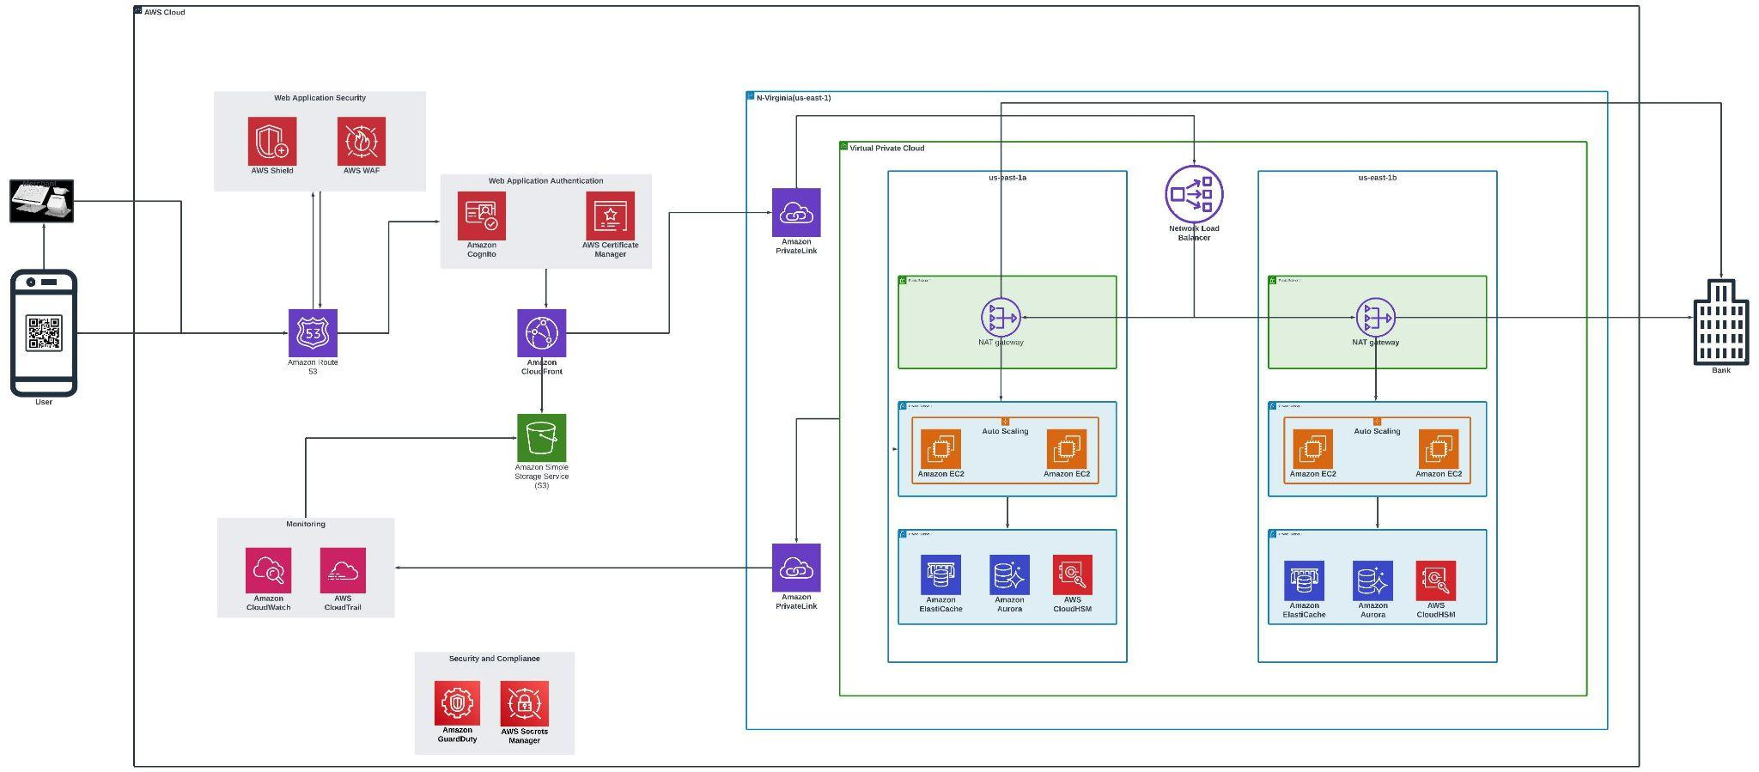
AWS Cloud Architecture

Slide 5
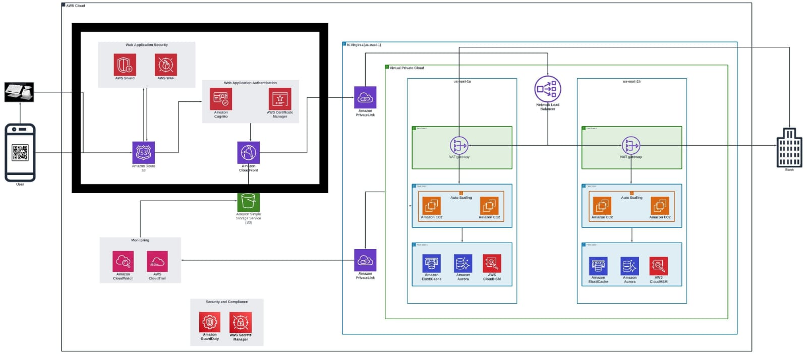
Authentication and Security

Slide 6
Authentication and Security
Key Components:
Amazon Route 53: Route 53 connects user requests to infrastructure running in AWS, such as Amazon EC2 instances, Elastic Load Balancing load balancers, or Amazon S3 buckets.
AWS WAF: AWS WAF is a web application firewall that lets you monitor the HTTP and HTTPS requests that are forwarded to your protected QR payment web application resources.
AWS Shield: AWS shield provides customization in application protection against DDOS attacks through integrations with AWS WAF.
Amazon Cognito: Amazon Cognito helps to add user sign-up and authenticate users through an external identity provider.
AWS Certificate Manager: We can configure a cognito user pool to use Amazon CloudFront proxy. Cloudfront uses ACM certificate in place to secure the custom domain.
Amazon CloudFront: Amazon CloudFront is a web service that speeds up distribution of your static and dynamic web content, such as .html, .css, .js, and image files, to your users.

Slide 7
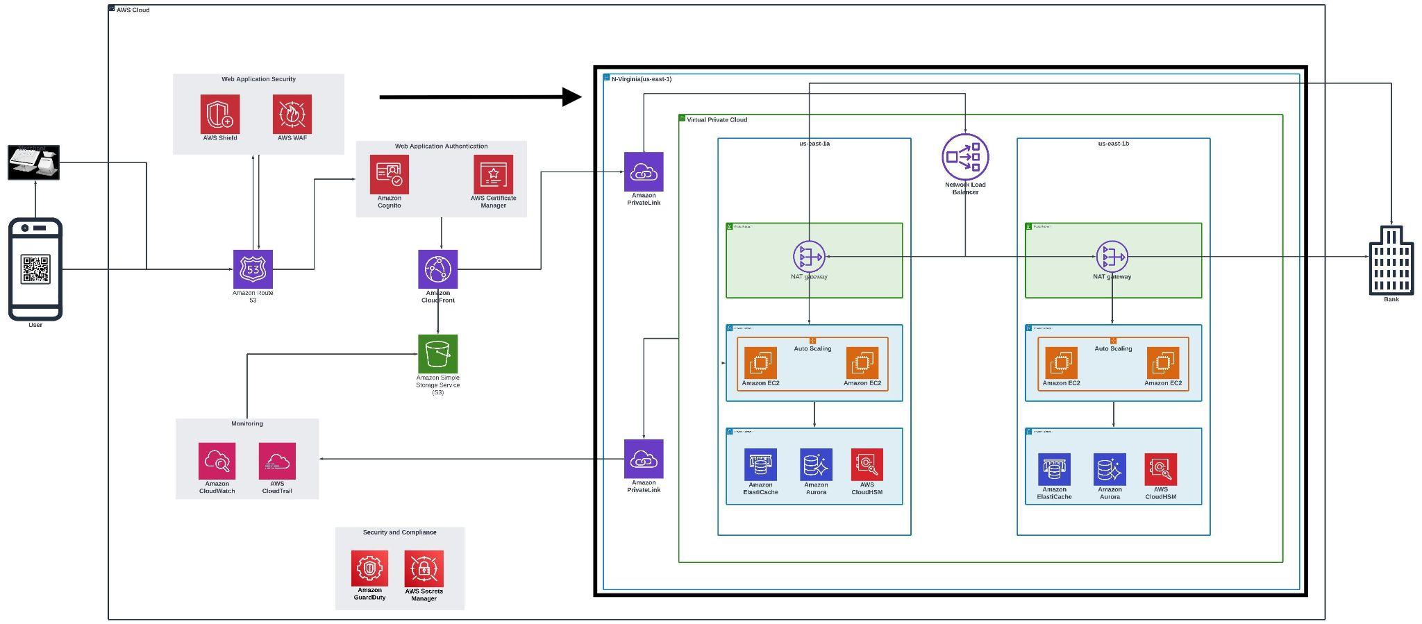
Networking and Content Delivery

Slide 8
Networking and Content Delivery
Key Components:
Amazon Private Link: AWS Private Link securely access services over the Amazon network without exposing them to the public internet, enhancing the privacy and security of your QR scan payment transactions.
Network Load Balancer: This load balancer distribute incoming traffic across multiple targets, ensuring high availability and reliability for your QR scan payment processing.
NAT gateway(Network Address Translation): Facilitate outbound internet traffic for instances in a private subnet, ensuring secure and controlled connectivity. Enable private resources in your VPC to access the internet for necessary updates and transactions in your QR scan payment system.
Amazon EC2: Amazon Elastic Compute Cloud is a web service that utilize scalable and resizable compute capacity to run applications, manage QR code data, and process payments efficiently.

Slide 9
Networking and Content Delivery
Key Components:
Amazon Elasticache: Improve the speed and responsiveness of your QR scan payment system by deploying an in-memory caching system, reducing database load times.
Amazon Aurora: Ensure high-performance and availability for your QR scan payment database with a fully managed, MySQL and PostgreSQL-compatible relational database..
AWS CloudHSM: Safeguard sensitive cryptographic material and secure your QR scan payment transactions with a dedicated Hardware Security Module (HSM) for key management and encryption.

Slide 10
Monitoring and compliance

Slide 11
Monitoring and compliance
Key Components:
AWS Guard Duty: Our first line of defense. Guard Duty continuously monitors for malicious activity, providing real-time threat detection.
AWS Secrets Manager: Safely manages and rotates credentials for our payment services, enhancing the security of sensitive information.
CloudWatch: Integrated with Guard Duty to trigger alerts and automate responses, ensuring swift action against potential security threats.
CloudTrail: Captures API events for auditing and compliance.

Slide 12
Monitoring and compliance
Automation, Response and monitoring:
Guard Duty + Cloud watch:automate responses like notifications based on Guard Duty findings, streamlining our incident response process.
Guard Duty + Secrets Manager: A powerful combination for comprehensive security monitoring and credential management.

Slide 13
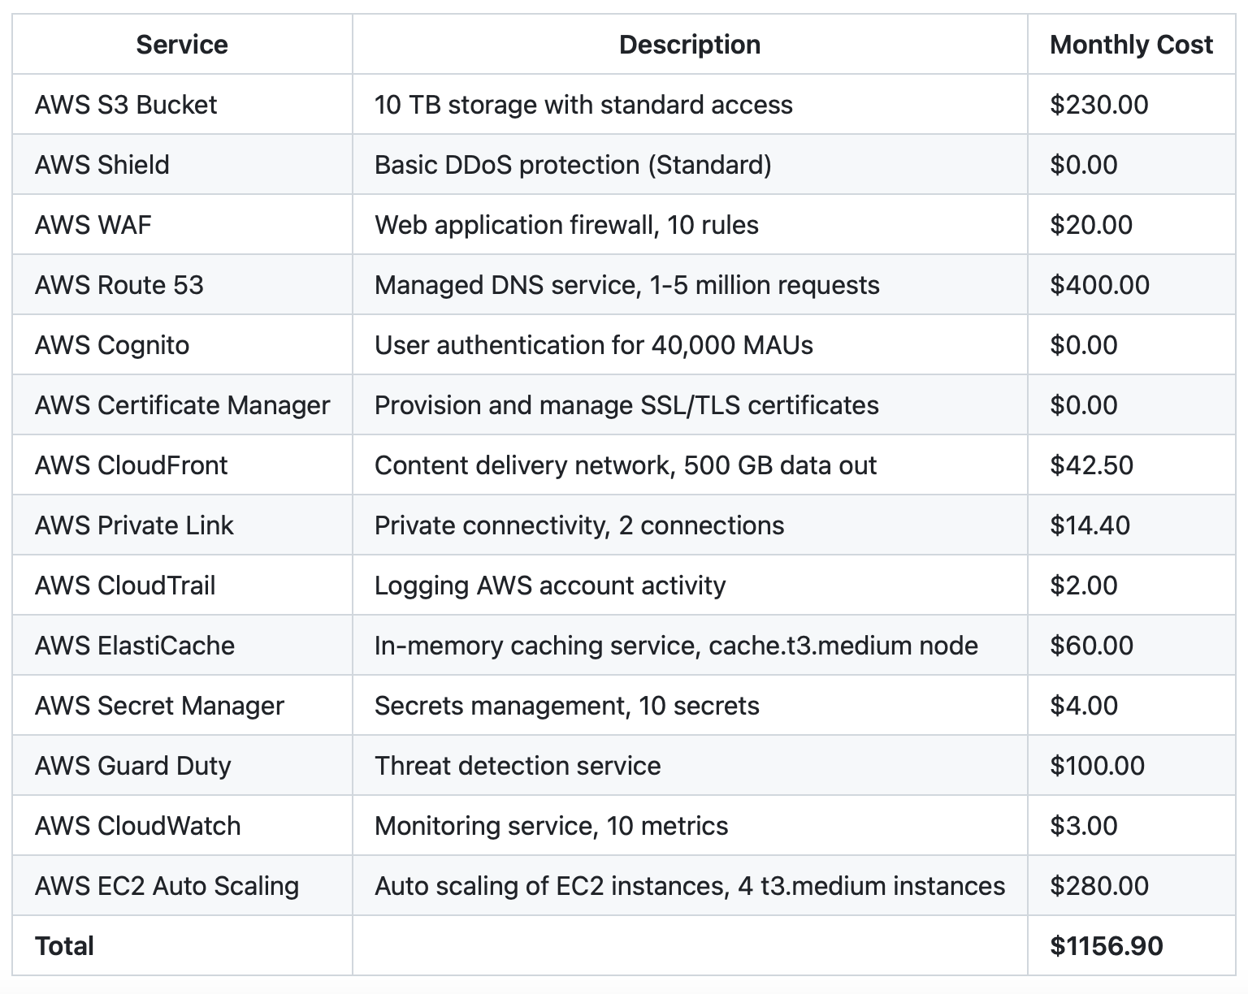
AWS Pricing

Slide 14
THE END

